Slide 1
Inventor iLogic Step by Step Debugging
Markus Koechl
Solutions Engineer PDM|PLM – Autodesk Central Europe

Slide 2
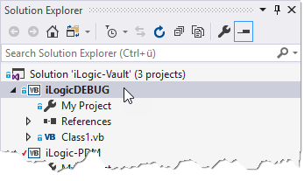
iLogic | Visual Studio Debugging
Connect Visual Studio to Inventor iLogic for step by step debugging
The iLogic-Vault Solution shares a debugging project ready to go
Empty VB Class
Notes:
1) „Snippets“ are pre-defined pieces of code for fast and convenient re-use. Double-click to insert into code editor window.

Slide 3
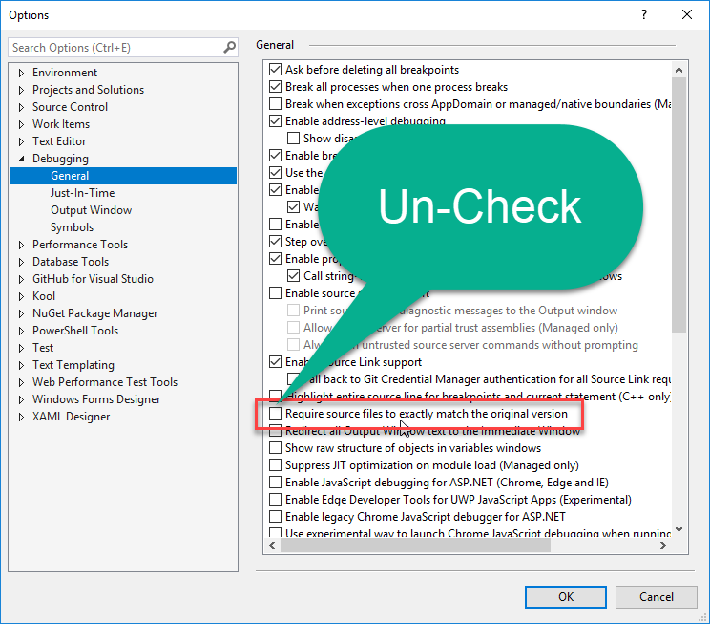
iLogic | Visual Studio Debugging
Required Setting to allow Visual Studio ignore the code differences of iLogic Syntax to VB.NET syntax

Slide 4
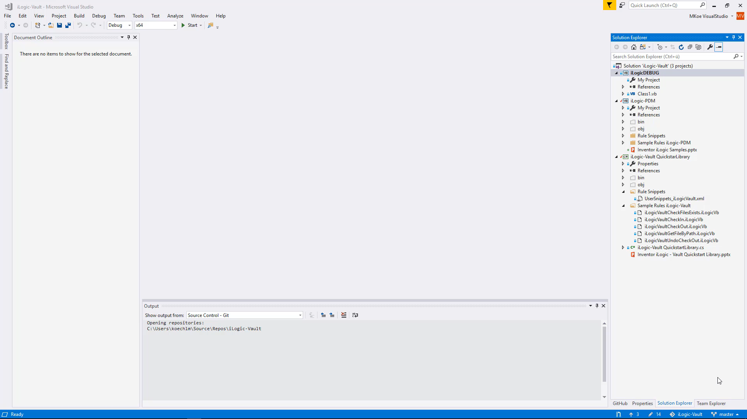
iLogic | Visual Studio Debugging

Slide 5
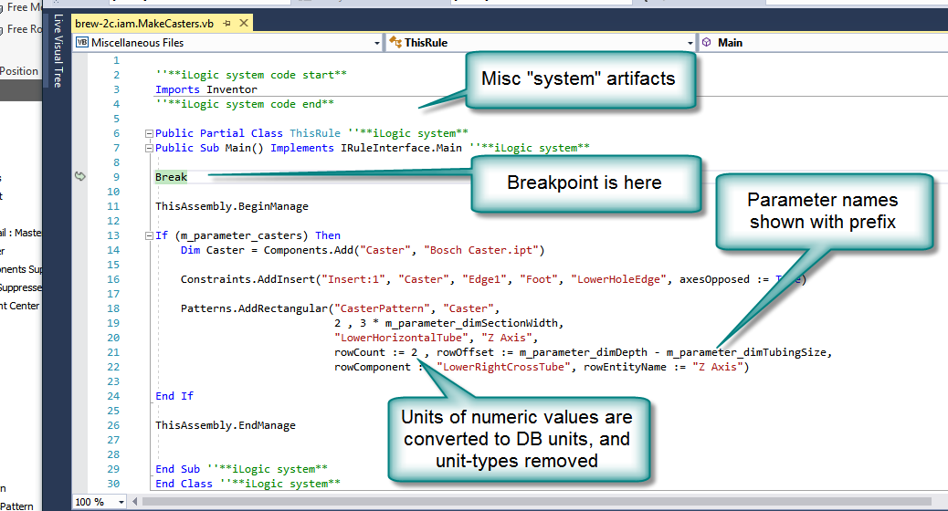
iLogic | Visual Studio Debugging
Additional Information & Tips

Slide 6
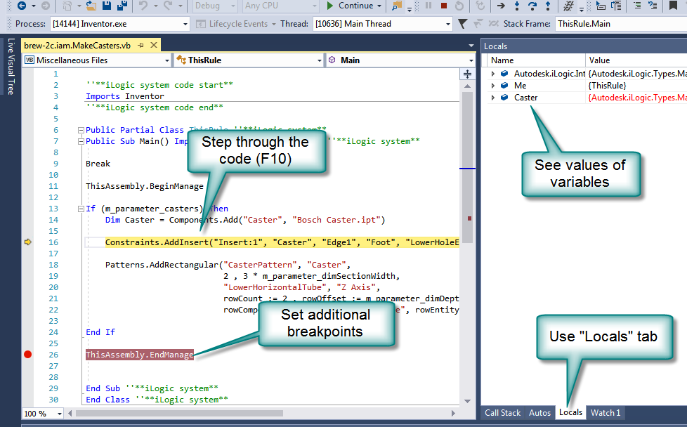
iLogic | Visual Studio Debugging
Additional Information & Tips

